Slide 1
Euler’s Theorem
MD. SHAHADAT HOSSAIN
Email: shahadatmathku@gmail.com
Euler's Theorem on Homogeneous Equations

Slide 2
Index
Homogeneous function
Euler’s Theorem on Homogeneous function
Problems related to Euler’s Theorem
Deduction from Euler’s Theorem
Problems related to Deduction from Euler’s Theorem
Exercise
Euler's Theorem on Homogeneous Equations

Slide 3
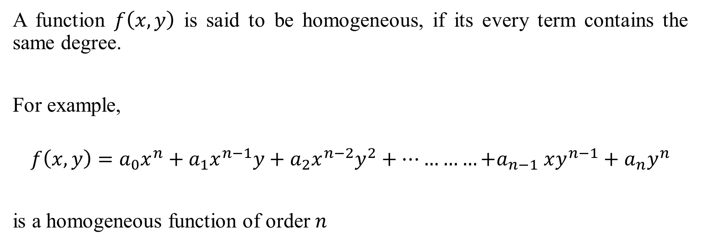
Homogeneous Function
Euler's Theorem on Homogeneous Equations

Slide 4
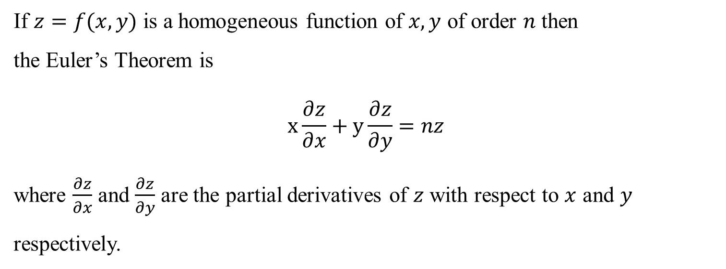
Euler’s Theorem on homogeneous function
Euler's Theorem on Homogeneous Equations

Slide 5
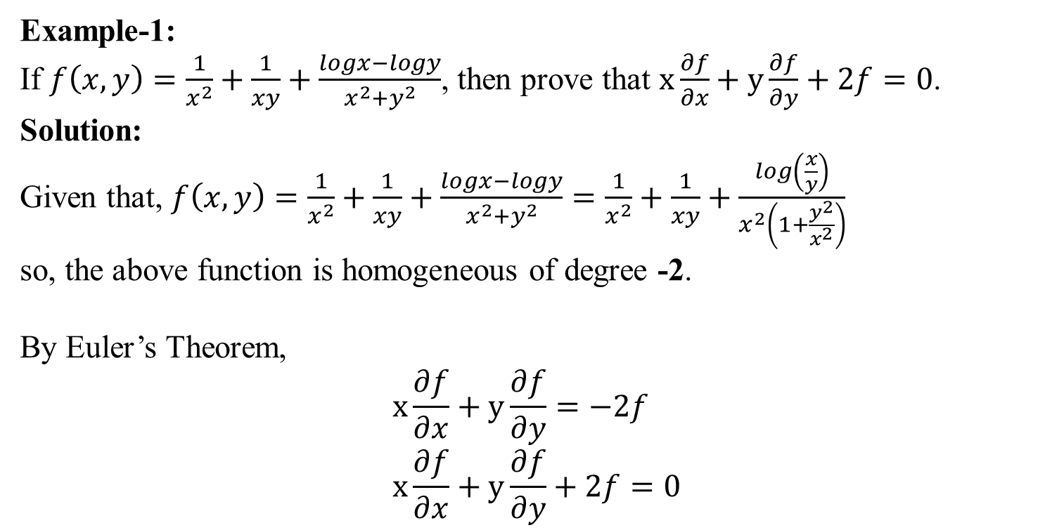
Euler’s Theorem on homogeneous function
(Proved)
Euler's Theorem on Homogeneous Equations

Slide 6
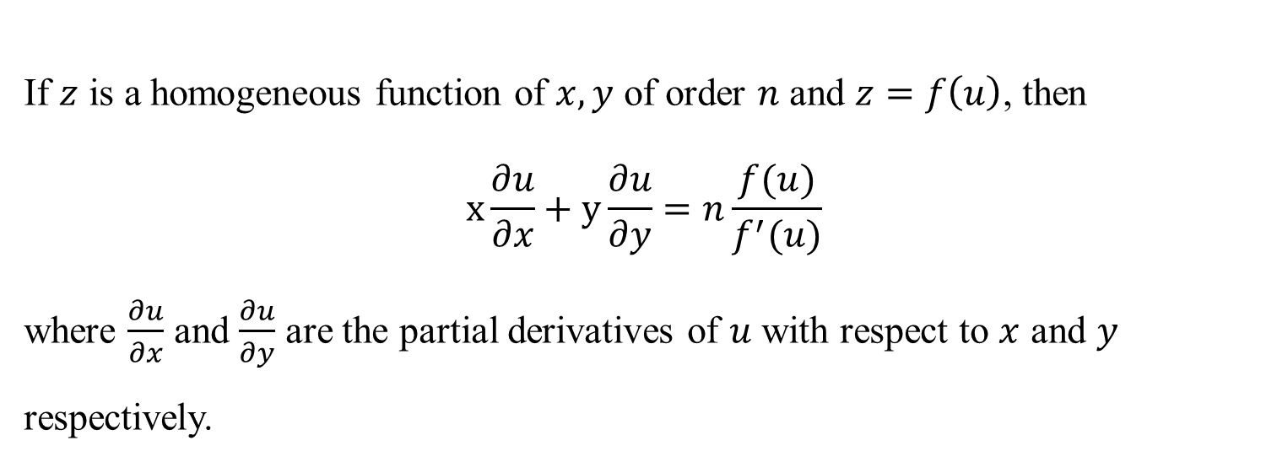
Deduction from Euler’s Theorem
Euler's Theorem on Homogeneous Equations

Slide 7
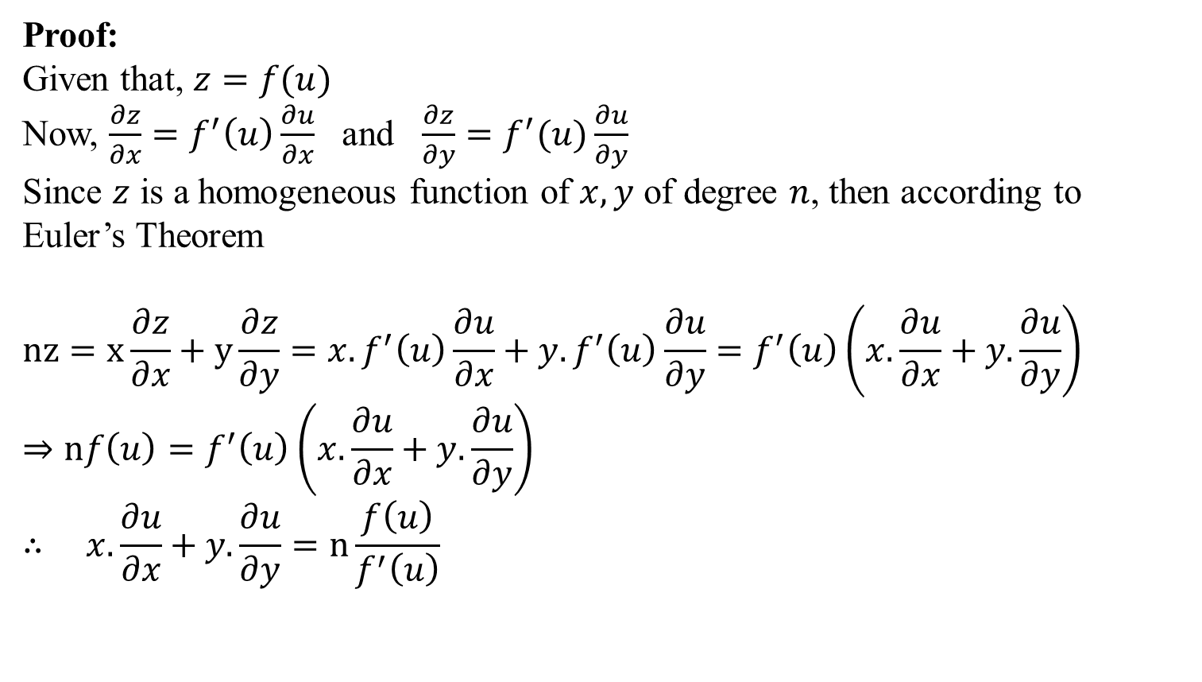
Deduction from Euler’s Theorem
Euler's Theorem on Homogeneous Equations

Slide 8
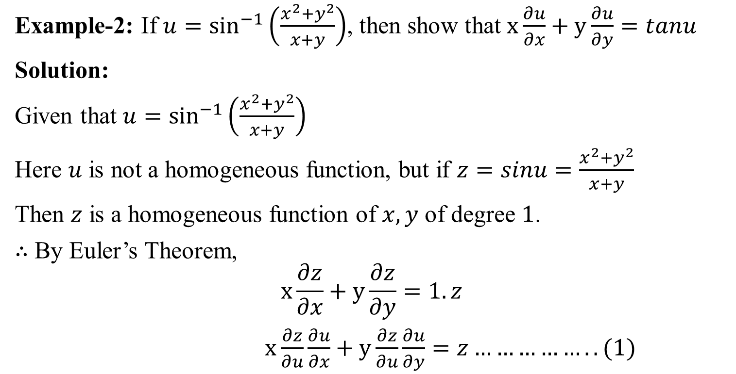
Example
Euler's Theorem on Homogeneous Equations

Slide 9
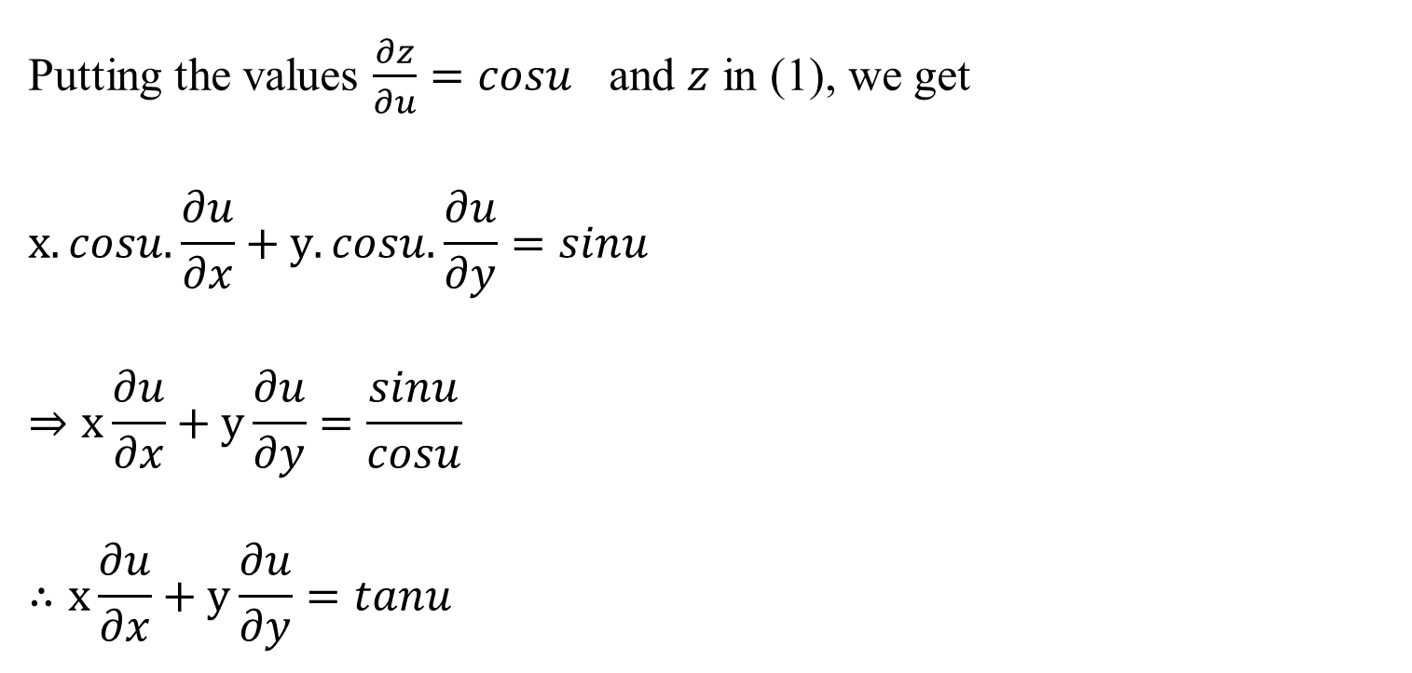
Euler's Theorem on Homogeneous Equations

Slide 10
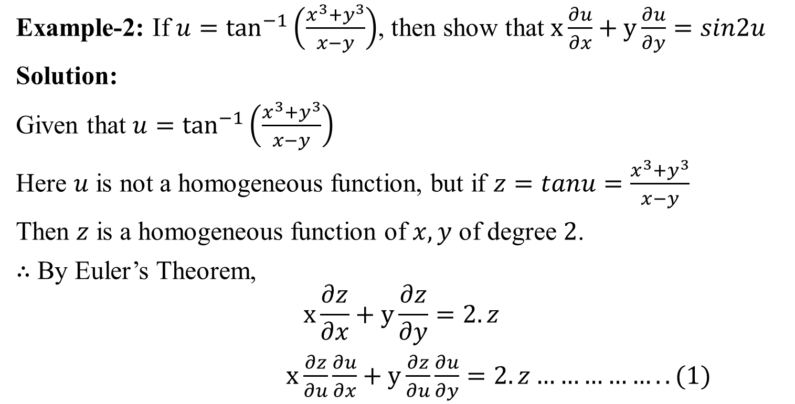
Example
Euler's Theorem on Homogeneous Equations

Slide 11
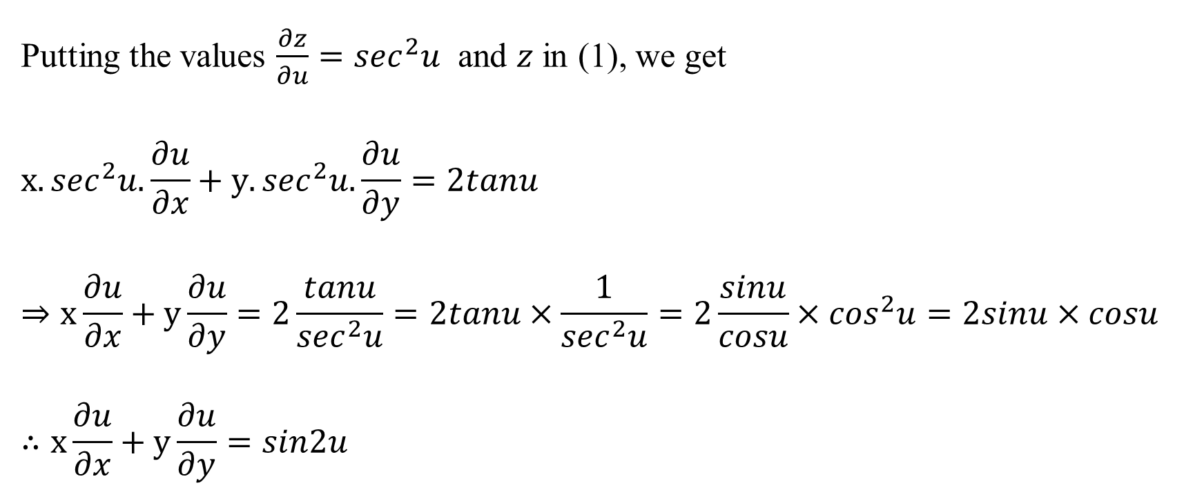
Euler's Theorem on Homogeneous Equations

Slide 12
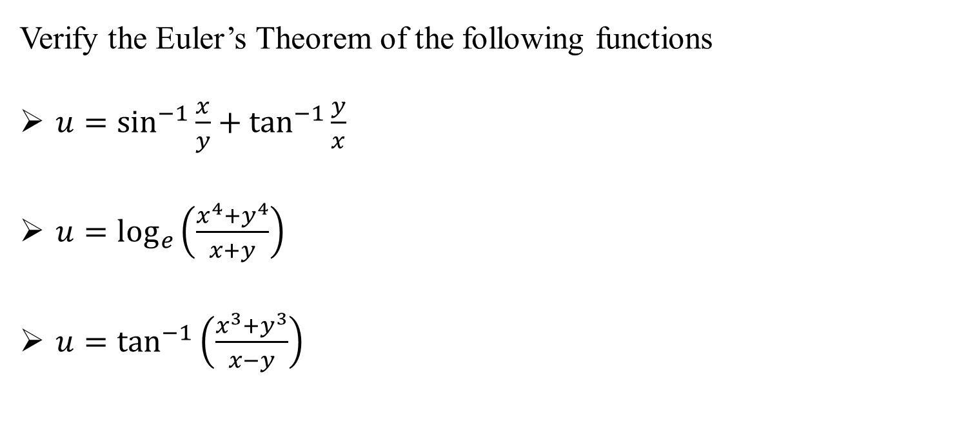
Exercise:
Euler's Theorem on Homogeneous Equations

Slide 13
STAY HOME
&
BE SAFE
Euler's Theorem on Homogeneous Equations

Slide 14
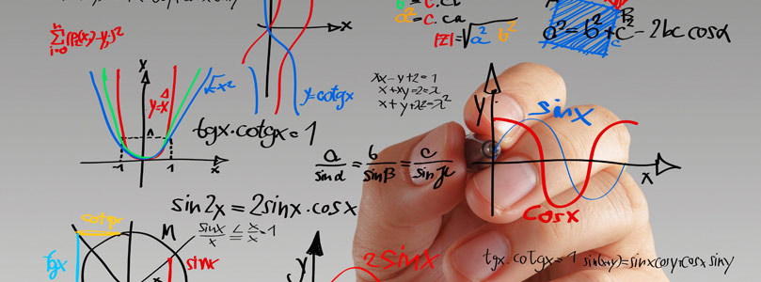
“Equations are much more important to me, because politics is for the present, while an equation is for eternity.”
— Albert Einstein

